Slide 1


SAP UI5 & FIORI with OData TRAINING
Anubhav Oberoy
Day – 5

Slide 2

Agenda – Day 5
SAP UI5
Under the hood of SAP UI5
Introduction to the MVC Architecture
Components of a UI5 Application
Creating our First UI5 Application
Introduction to the SAP UI5 SDK
Understanding how UI5 works
Views in UI5
Introduction to XML
Concept of controller in UI5
Control Hierarchy
Hook Methods of the controller
Concept of Model in UI5
Understanding Important point related to models
Steps to create model
Addressing model in views

Slide 3
Steps to create a Fresh NodeJS Project
Run a command called npm init – Create a new Nodejs project
Answer some simple questions like project name, starring file, author, version, description, …
We can mention the starring file of the project. We use myfirstnode.js as starring file, but in most of the cases we use index.js to follow the best practices.
We can just add some code to this file with all the modules
Then we run npm install module_name --save OR npm install module_name --save-dev to add a module to our project
To run the project, we can use the ‘node .’ command in the terminal.
npmjs
Steps to use an external library using node js
Find the library (module) of your purpose on npmjs and check its documentation
Use require statement
We have downloaded this library in local project – npm install MODULENAME
We need to add all the required module dependencies inside package.json file
We only ship our project to other developers/system
In the new system, we run npm install It will read all required modules and
Automatically download those dependencies.
npm install
Laptop
Project+
Module
Laptop
Project

Slide 4
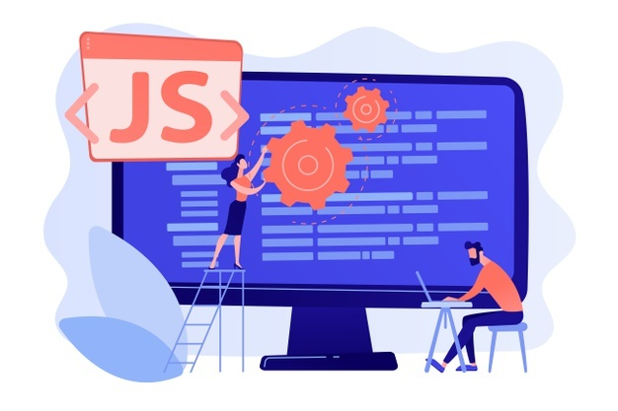
Exercise: First NodeJS
In this exercise we will see how to create a server using the NodeJS.
We will try to get some date using the NodeJS server in the browser.
We will also integrate an html page with the NodeJS.
To initialize a NodeJS project we need to run npm init command in terminal.
Exercise code/resource:
myfirstnode.js
reuse.js

Slide 5


What is SAP UI5?
SAPUI5 (SAP user interface for HTML5) is a collection of libraries that you can use to build desktop and mobile applications that run in a browser. With the SAPUI5 JavaScript toolkit, you can create web applications using HTML5 web development standards.
SAP UI5 is a framework which is used to develop Responsive web applications to run on any platform, any browser and any OS.
Responsive
App which can adapt itself according the different devices
Framework
It’s a collection of Libraries.
Library
Collection of classes.
Classes
Collection of methods, Attributes, Events
Software Innovation
Hardware Innovation
Trainer: Anubhav Oberoy & Nishan

Slide 6
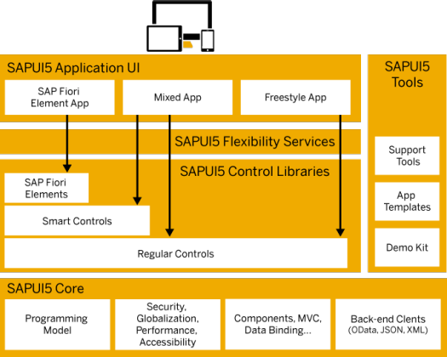
Under the Hood of SAP UI5
SAPUI5 simplifies web application development. A variety of UI controls, ranging from basic elements to complex UI patterns, can be combined for an appealing layout. All UI controls leverage a consistent design language and coherent UX patterns. SAPUI5 flexibility services let you easily adapt the UI of an app and store the changes in a layered repository.

Slide 7
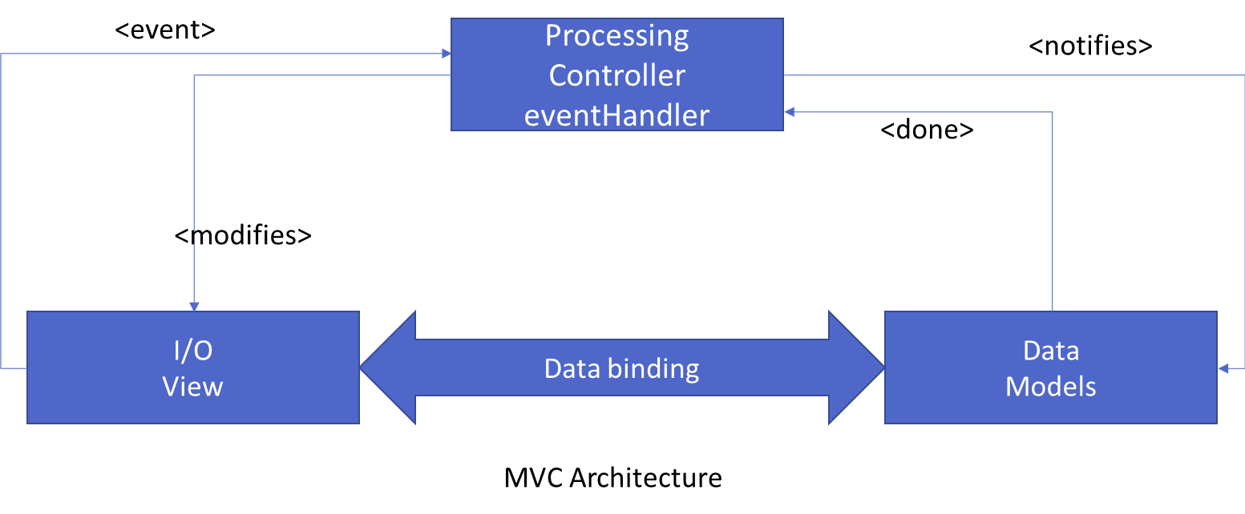
Introduction to MVC Architecture
MVC stands for Model, View, Controller.
Model:- The model component is a freely composed class that will keep the application data and do manipulations on it. All database accesses are done within the model.
View:- The View is responsible for defining the user interface to users. When a user sends a requests from his device, the view is responsible for data view as per the request submitted.
Controller:- The Controller is used to control the data and view events as per user interaction by updating the view and model.

Slide 8
Components of UI5 Application
The UI5 framework is built on top of open standards like HTML5, CSS, JS, and jQuery. We use MVC architecture to create applications using SAPUI5.
BAS
App
Developer
SAPUI5 Runtime Component
HTML+CSS+JS
sap.m
sap.ui.comp
sap.ui.table
sap.ui.layout
Renderer
sap.ui.core
sap.ui.unified
sap.ui.core.mvc
HTML5
CSS
JS
jQuery

Slide 9
Creating first UI5 Application
Now we will create our first UI5 application.
In this application we are going to add a simple button provided in SAP UI5.
When the button is pressed it shows an alert popup at the top.
Steps to Create a UI5 app
Start with a project folder and all the productive files inside the webapp folder
Initialize a node project using (npm init)
Add a manifest.json file inside UI5 project (inside webapp) which talks about our project properties (sap.app, sap.ui, sap.ui5)
Mention that this is a UI5 type project hence we run a command called ui5 init
Create an HTML file index.html inside webapp folder.
Create HTML Head and body
Add the Bootstrap code for HTML, load sap ui5 from CDN https://sapui5.hana.ondemand.com/resources/sap-ui-core.js
Along with step 2, we will specify theme, library, and the path where all our project resources are present
Create object of our first view
Place this view in the body
Now create a view/Our view and in this view, we will add the control (JS View), when we implement view, we need to add 2 methods createContent and getControllerName
Create a controller (like a class) for this view, we can also put a constructor method onInit
Execute project using ui5 serve command

Slide 10

Exercise: First UI5 Project
Now we will create our first ui5 application by following the steps mentioned in the previous slide.
Exercise code/Resource:
index.html
MyView.controller.js
MyView.view.xml
mainfest.json

Slide 11
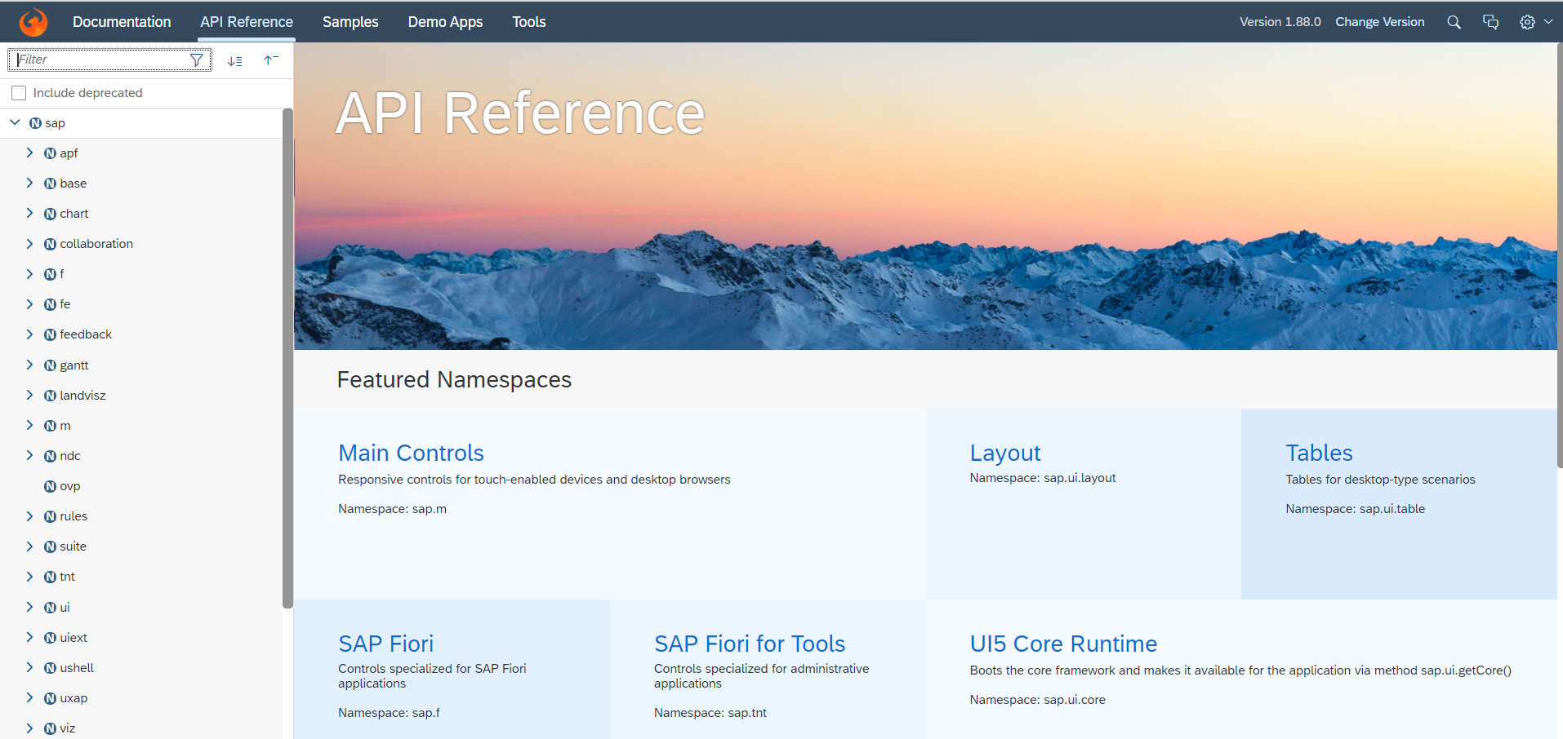
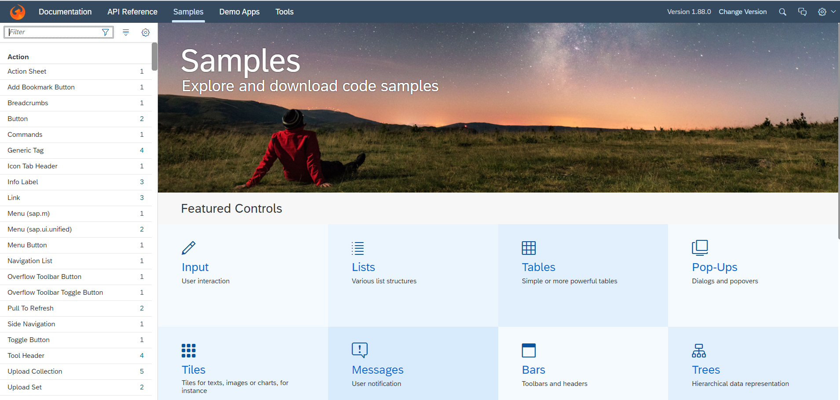
Introduction to UI5 SDK
Documentation of SAP UI5 is available at the SAPUI5 Software Development Kit.
We can access the SAP UI5 API’s at the Documentation page of SAP UI5 or you can use the link to go to sap’s API screen - LINK
We can directly search the required api’s on the SDK.
SDK contains the sample of all the controls which we can use in UI5
SAP UI5 API reference screen
SAP UI5 Sample reference screen

Slide 12
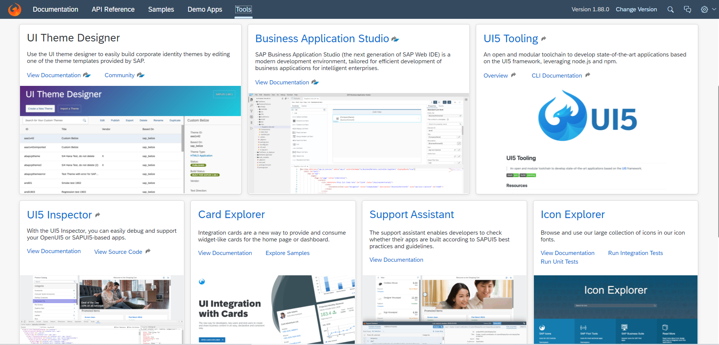
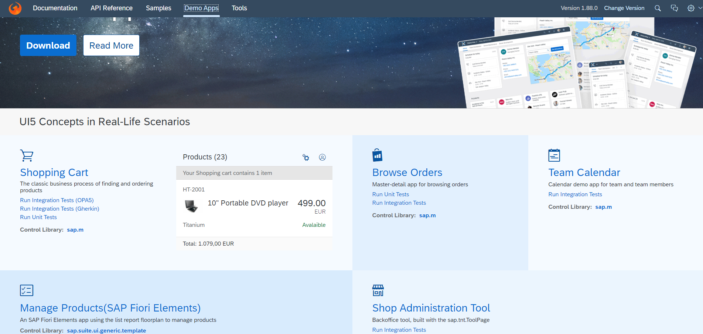
UI5 SDK continues…
UI5 SDK contains tools to make the development smooth for the developers.
It has UI5 icon packs which can be directly accessed for the UI5 SDK’s Tool Screen (Link).
SAP UI5 SDK provides us the demo application, So we can get an idea about how to create different type of applications using UI5 controls
UI5 SDK Tools Screen
UI5 SDK Demo Apps Screen

Slide 13
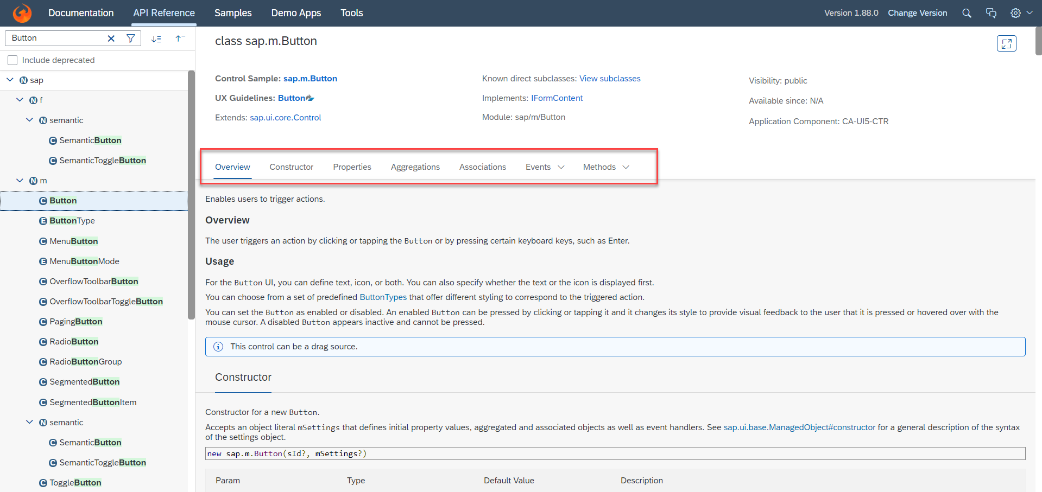
UI5 SDK continues…
When we search and open any API we see a screen similar to one which is shown below.
Every API contains different kind of:
Properties,
Aggregations,
Associations,
Events,
Methods

Slide 14
How UI5 Framework works
Browser
CDN
1
View
getControllerName
Retern CONTROLLER
createContent
return CONTROLLER_OBJ
Index.html
SAP UI5 Framework
2
var oView = new sap.ui.view({
viewName: “mickey.view.Main",
type: "JS“
});
6
C
5
Renderer
Controller
onInit()
C
HTML + CSS
3
4

Slide 15
Views in SAP UI5
View is responsible to manage information display to the users.
Views are based on Model.
There are Four types of views in SAP UI5, these are listed below:
XML View:- It is in the XML format. The file name ends with the extension “.view.xml”. There are no predefined methods in the XML view.
JS View:- It is in JavaScript format. The extension of the view file is “.view.js”.
JSON View:- It is in JSON format. The file name ends with the extension “.view.json”.
HTML View:- It is in HTML format. The file name ends with the extension “.view.html”. Here we create the controls within the <div> tags, as we do while developing HTML pages.
Percentage Usage of Views:
2%
99%
JOSN View – 0%
HTML view – 0%
JS View is used only in 2% of the views.
XML Views are the mostly used views now a days.
The use of JSON and HTML views are negligible

Slide 16
XML View
What is XML?
XML stands for eXtensible Markup Language, it was originally developed to move data from one to another technology. It became popular to communicate between heterogeneous technologies.
XML is a tree data structure. Unlike HTML, we can use custom tags. Every programming language must support XML.
Portal
Java
App
ABAP
If_ixml
xml
xml
Data Objects → XML – Rendering
XML → Data Object - Parsing

Slide 17
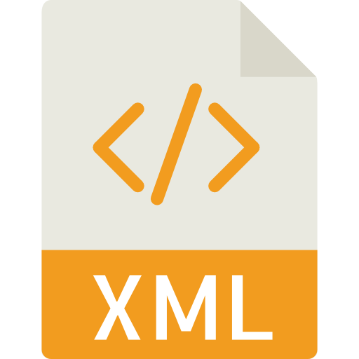
Structure of XML
<data>
<empStr>
<empId>5000</empId>
<empName>Jack</empName>
<salary>9500</salary>
<currency>EUR</currency>
</empStr>
<empTab>
<row>
….
</row>
</empTab>
</data>
Root Element
Child Element of <data> tag
Child Element of <empStr> tag
Skeleton of XML View
<core:View xmlns:core=“sap.ui.core” xmlns=“sap.m” controllerName=“pathOfContro.”>
<Button text=“Click Me”></Button>
</core:View>

Slide 18
Controller in UI5
A controller contains methods that defines how models and views interact.
You define a simple controller as follows:
sap.ui.define([ "sap/ui/core/mvc/Controller" ],
function(Controller) {
"use strict";
return Controller.extend(“Address of Controller", {
// controller logic goes here
});
});
Special Class which inherits from standard SAP module called sap/ui/core/mvc/Controller
Skeleton of any JS file in SAP UI5 – Considered as a class
sap.ui.define([“dependencies”, “dep2”, “dep3”],
function(oD1, oD2, oD3) {
--logic—
}
);
Modules

Slide 19
Basics of Controller
For every Control if there is a property, we will have setter and getter methods for that property. For example, if there is a enabled property, we will have setEnabled and getEnabled methods.
To access the methods and properties of a UI Control, We cannot use the document object which is a plain HTML element object.
To obtain UI5 element object, we need to first get View Object,
this.getView()
On top of App object, we can get UI5 element object and finally
byId(“just pass ID”)
we can call any methods of UI5
For every event in UI5, we have attachEvent, detachEvent, fireEvent methods as well, which can be used to link, delink and trigger event programmatically.
When we use JS view, inside the event handler, this pointer will point to the current control object not the class (controller) object. In order to force this pointer to work like our Controller object, we need to pass it explicitly. This ONLY applies in JS View.
Just now you showed getting view object from controller, this.getView(), Using this view object also can I get my control objects? Just to avoid sap.ui.getCore() – You can but in XML View
When we use XML views, the ID of the control will be viewId--controlId

Slide 20

Basic of OOPS
A relation between 2 classes which are not of same family is called association
Aggregation – lose coupling, both objects can function independently, should have relationship
Composition – tight coupling, both objects must CO-exist, must have relationship, they cannot function independently
Passenger
+passportno, +name, +nationality +isfamily
Drive(), check-in(), securitycheck()
0..*
Airplane
+height +width +color
Fly(), land(), load()
Airplane
+height +width +color
Fly(), land(), load()
Wings
+height +company +size
Rudder() alerons()
1..*
Passenger plane
+No_of_seats
Bording()
Cargo plane
+Cargo_space
Loading()
Passenger plane
+No_of_seats
Bording()

Slide 21
Control Hierarchy
sap.ui.base.ManagedObject
Syntax to create object
var oName = new libraryName.ControlName({
prop: Val,…
});
Note:- Whenever we see a control, and if we are unable to find a property, association, event or function in that class, check its parent class.
sap.ui.core.Element
sap.ui.core.Control
sap.m.Button
sap.m.InputBase
sap.ui.view
sap.m.Table
sap.ui.layout.form
sap.m.Input
SimpleForm
sap.m.Column
Some of the Frequently used controls in SAP

Slide 22
Hook Method of Controller
onInit()
onBeforeRendering()
It is a function which gets called immediately after UI5 creates the object of our controller. It is like constructure of a class. We can use this to initialize our class variable
It is a method which gets called MULTIPLE times, Before every time the view is displayed to the user. We can use this method for pre-processing on a view.
IN
BR
EX
AR
onExit()
onAfterRendering()
It is a function which gets called before the instance of our controller gets destroyed. It is like destructor of a class.
We can use this to write clean-up code.
It is a method which gets called MULTIPLE times, After every time the view is displayed to the user. This method can be used to show effects to the user.

Slide 23

Exercise: Form Control in UI5
In this exercise we will create a login form which will have a two input fields and a button.
After this we will create a simple form in the XML view, using the simple form class.
Exercise code/resource:
MyView.view.xml
MyView.controller.js

Slide 24
Models in SAP UI5
The various model types supported by SAPUI5 are:
OData model
JSON model
XML model
Resource model
Each model in SAPUI5 is mainly used to bind controls to the data brought in. The JSON model is a client-side model which is recommended for datasets with small amounts of data.
Usage of Models:
%
100
100
100
95
80
Usage in Percentage
60
40
40
20
Models
OData
JSON
XML
Resource

Slide 25
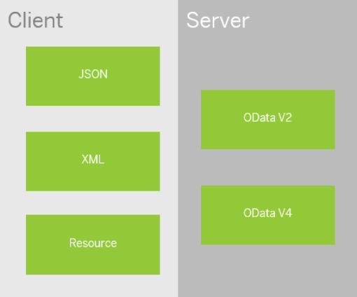
Model Basics
All the models in SAP UI5 are characterized in two different parts:
Client-Side Model: -
A model which keeps all the data in the browser. We use client-side model for manipulating data (like internal table).
Server-Side Model: -
Keeps data on server side, and ON-demand, it is loaded by client using the server-side model.
We can use the APIs (Methods) provided by SAP to access data from model
We need to get model object using methods
getModel(modelName)
setModel(modelName)
From model object we get access to the data using methods
setProperty(sPath, sValue)
getProperty(sPath)

Slide 26
Steps to Create a Model
3 Easy Steps to Create a Model
Step 1: Create a brand-new object of the Model
To Create JSON Model - var oModel = sap.ui.model.json.JOSNModel()
To create XML model – var oModel = sap.ui.model.xml.XMLModel()
To create Resource model – var oModel = sap.ui.model.resource.ResourceModel()
To create OData Model – var oModel = sap.ui.model.odata.v2.ODataModel()
Step 2: Set or Load the data in the Model
oModel.setData({});
oModel.loadData(filePath);
Step 3: Make the model aware to the application/view
sap.ui.getCore().setModel(oModel);
this.getView().setModel(oModel);
Create object of the Model
Set/Load Data in Model
Set Model at View Level

Slide 27
How to Address Model Properties?
In the json data we can make address as “Every curly braces is converted to / and every array item is converted to /index”.
{
"empStr": {
"empId": 0001,
"empName": "Anubhav",
"salary": 8000,
"currency": "USD"
},
"empTab": [{
"empId": 0009,
"empName": “Ananya",
"salary": 9500,
"currency": "USD“
}, {
"empId": 0010,
"empName": “Shwetha",
"salary": 10000,
"currency": “EUR"
}]
}
Q: what is the salary of Anubhav
- /empStr/salary
Q. What is the emp name of emp 0001
- /empStr/empName
Q. What is the salary of Shwetha
- /empTab/1/salary
Q. What is the empId of Ananya
- /empTab/0/empId

Slide 28

Exercise: Models and Model Binding
Model Exercise 1: Model Creation code within controller
In this exercise we will create a JSON model using a JavaScript Object.
After Creating the model, we will bind the model to the XML view in a Simple Form
Exercise code/resource:
MyView.controller.js
MyView.view.xml
Model Exercise 2: Model Creation code in models.js file.
In this exercise we will create a model.js file, In that file we will write code to create the model dynamically.
After that we will create two model and bind them with the form and on click of a button the model will be flipped.
Exercise code/resource:
MyView.controller.js
MyView.view.xml
models.js
mydata.json
mydata2.json

Slide 29

End of Day 5

Slide 30

Questions

Slide 31

Anubhav Oberoy

Slide 32


We’re committed to empower you to be
Most Desirable Resource
through powerful training solutions.
We build the workforce of the future.
250+
Corporate Clients
30,000+
Learners Trained
25000+
Learners Placed
FREE WEBINARS
Sign up for free webinars with industry experts every fortnight!
Enroll Now!
Contact us today!
https://anubhavtrainings.com/

Slide 33




More from AnubhavTrainings.com

Slide 34
Title
Content

